Slide 1
Blockchain Key-Pair

Slide 2
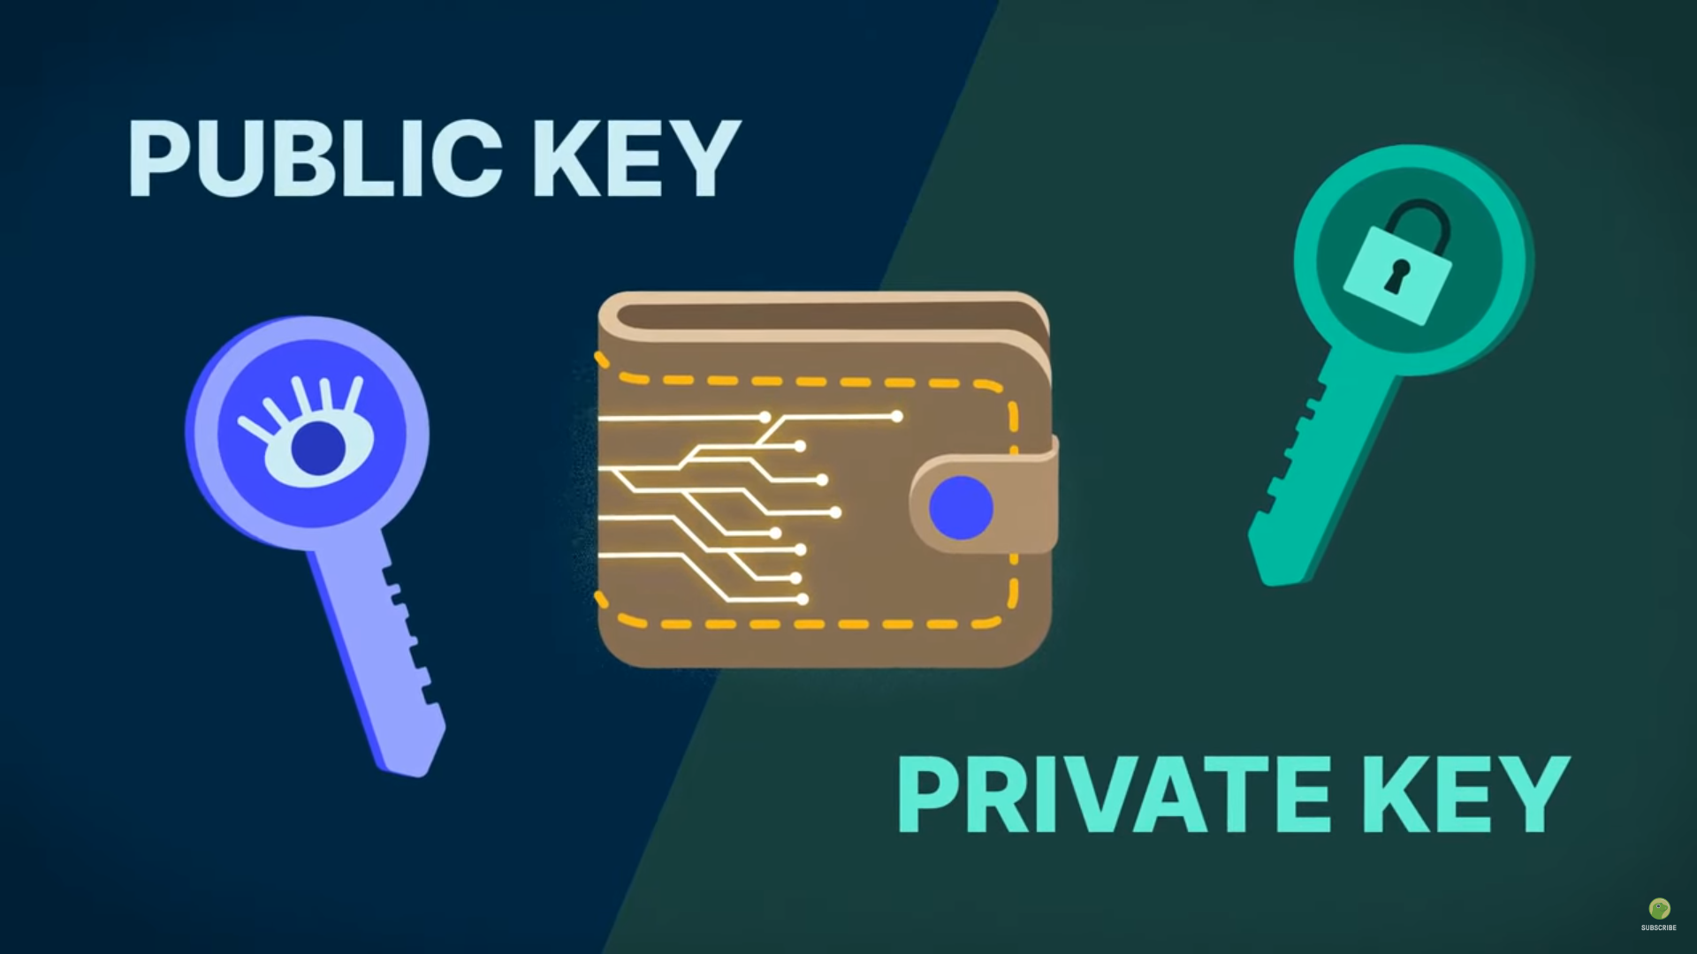
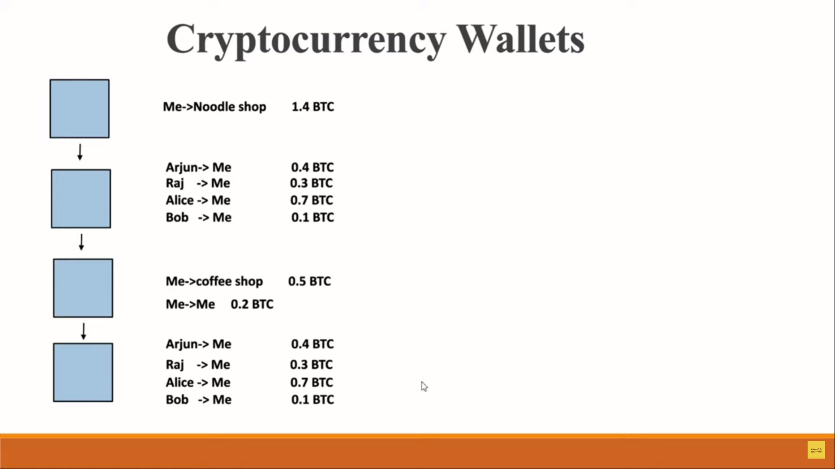

Slide 3
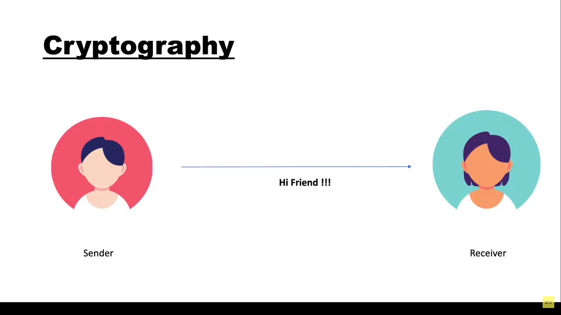

Slide 4
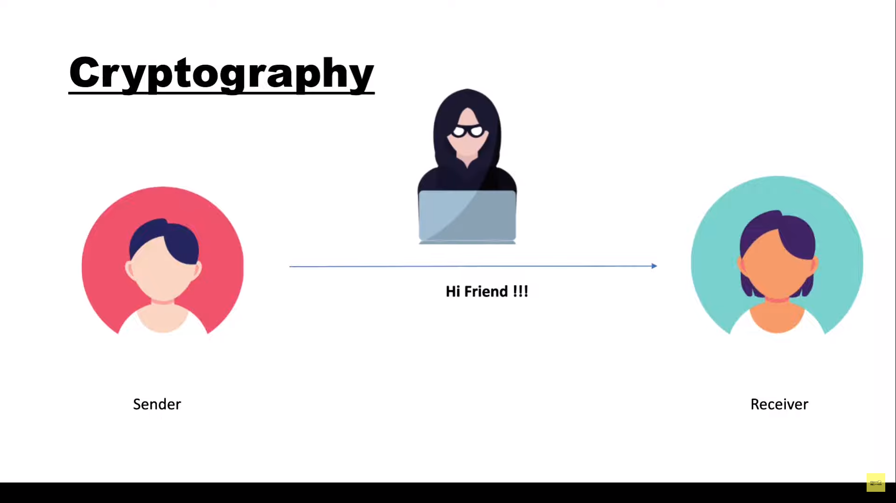

Slide 5
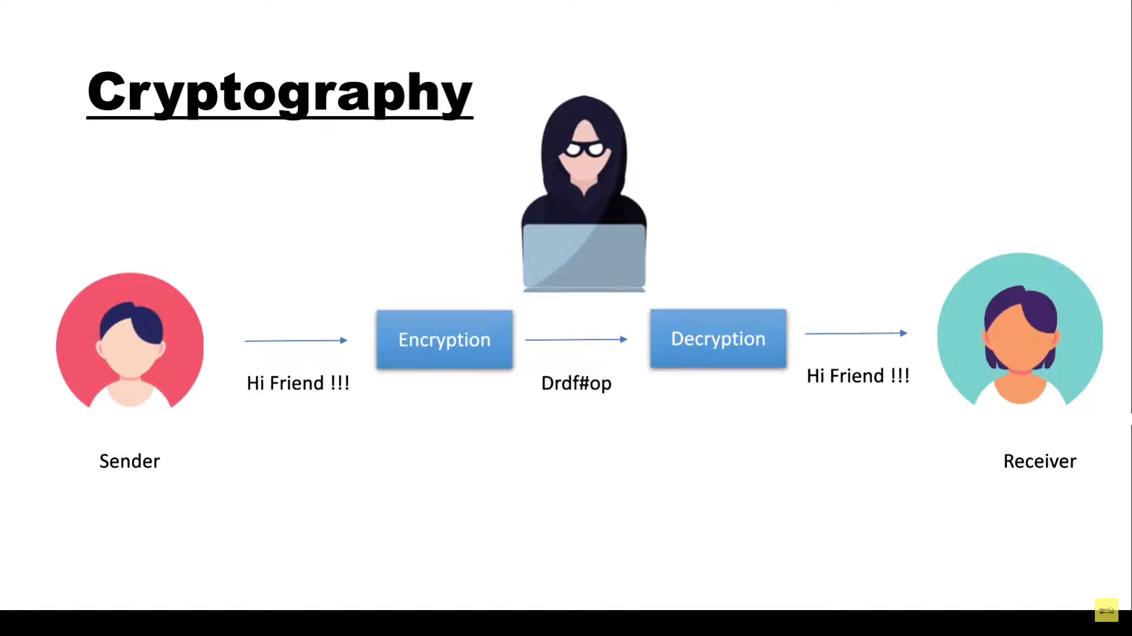

Slide 6
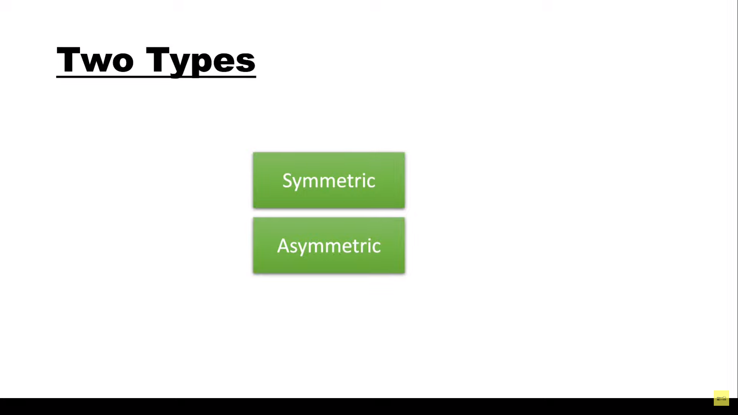

Slide 7
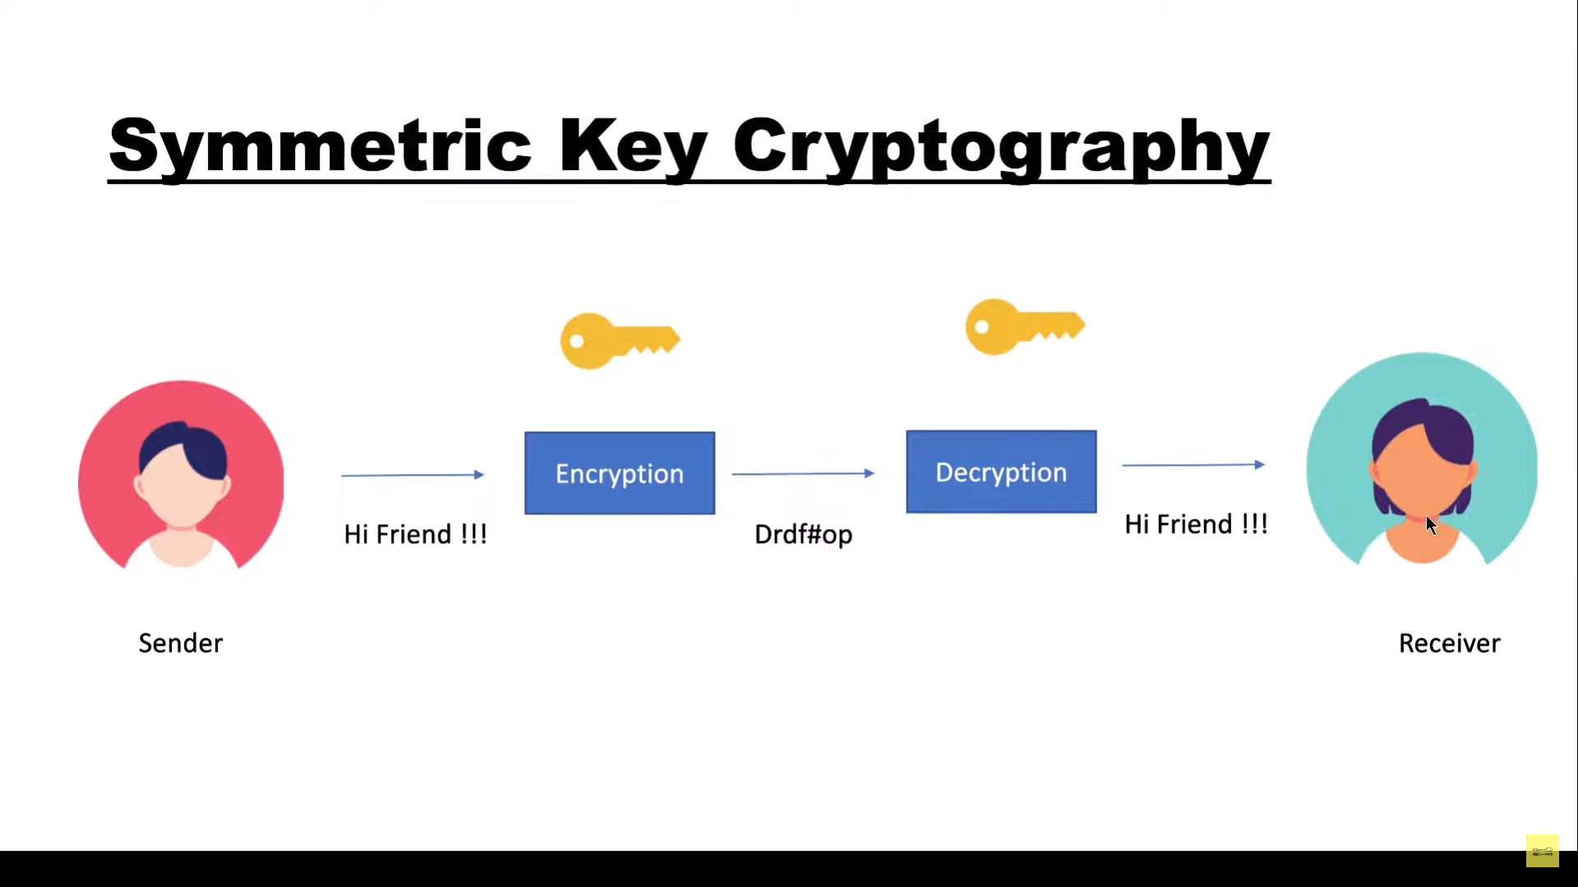

Slide 8
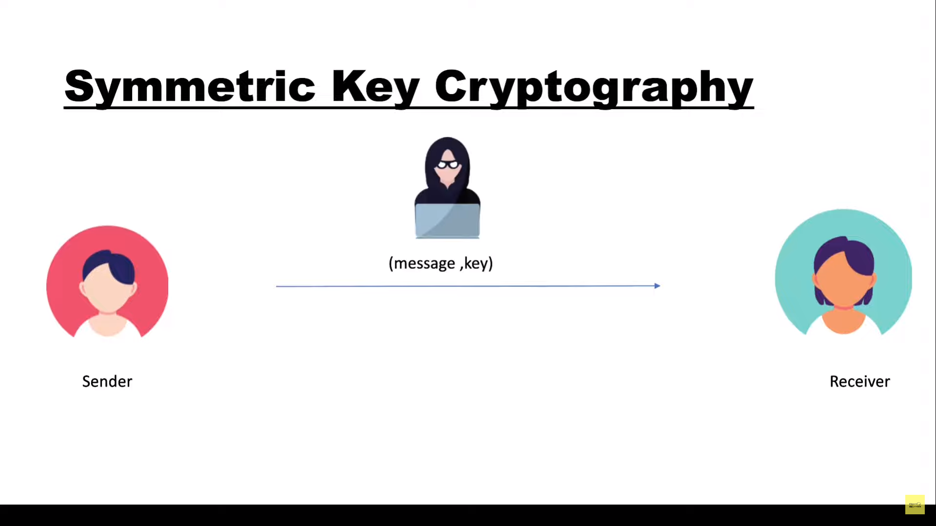

Slide 9
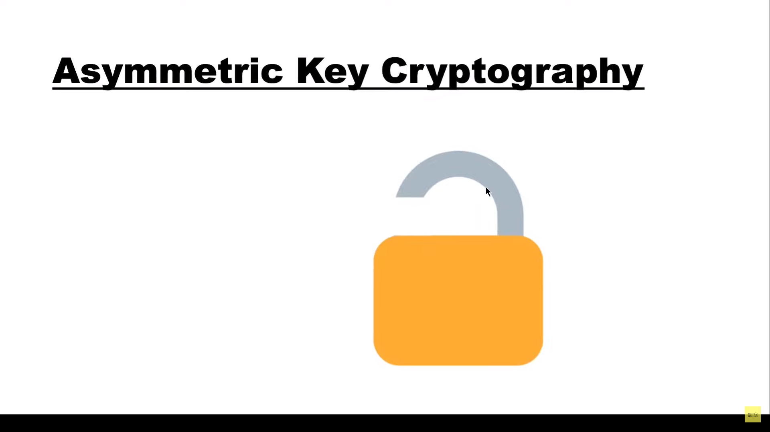

Slide 10
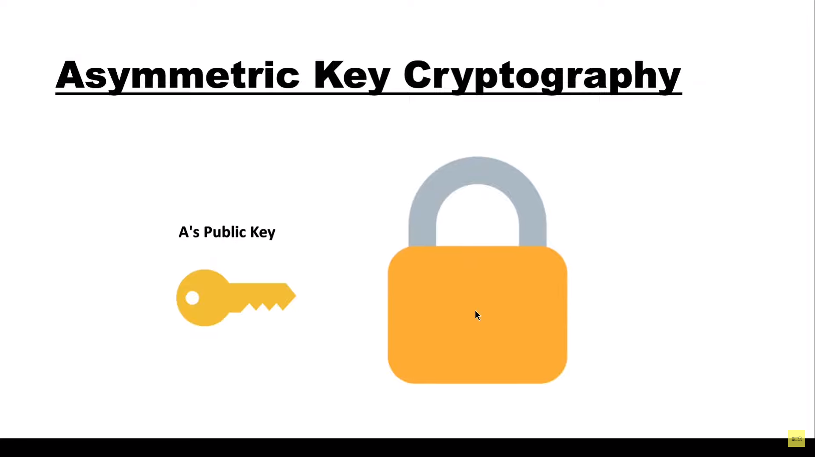

Slide 11
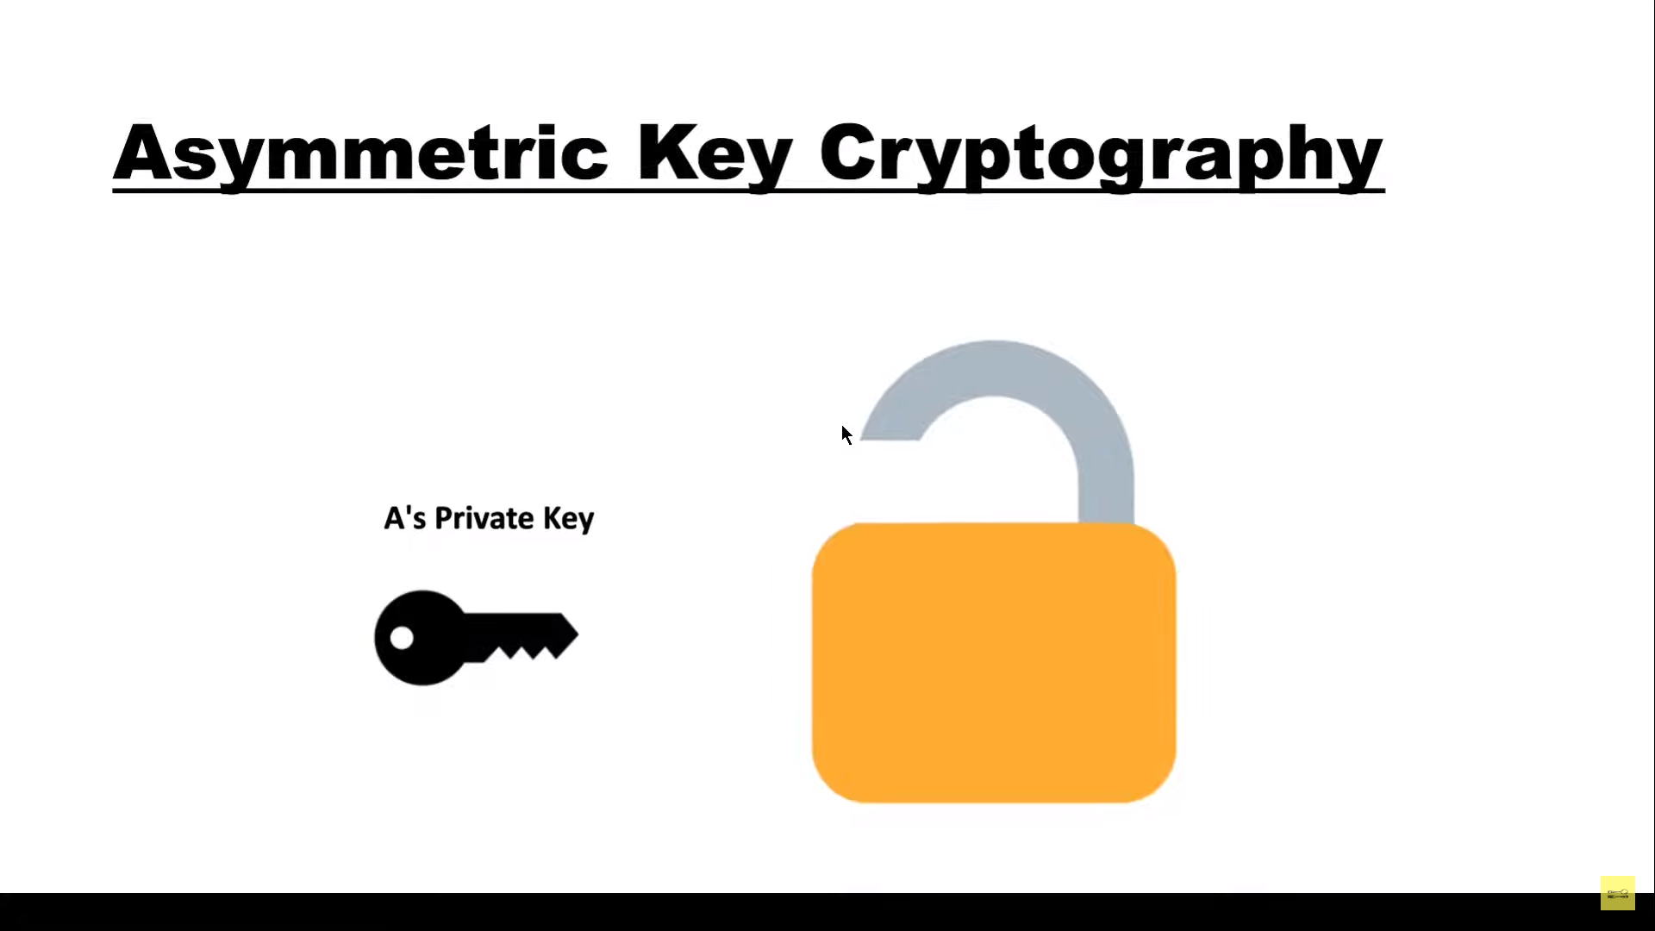

Slide 12
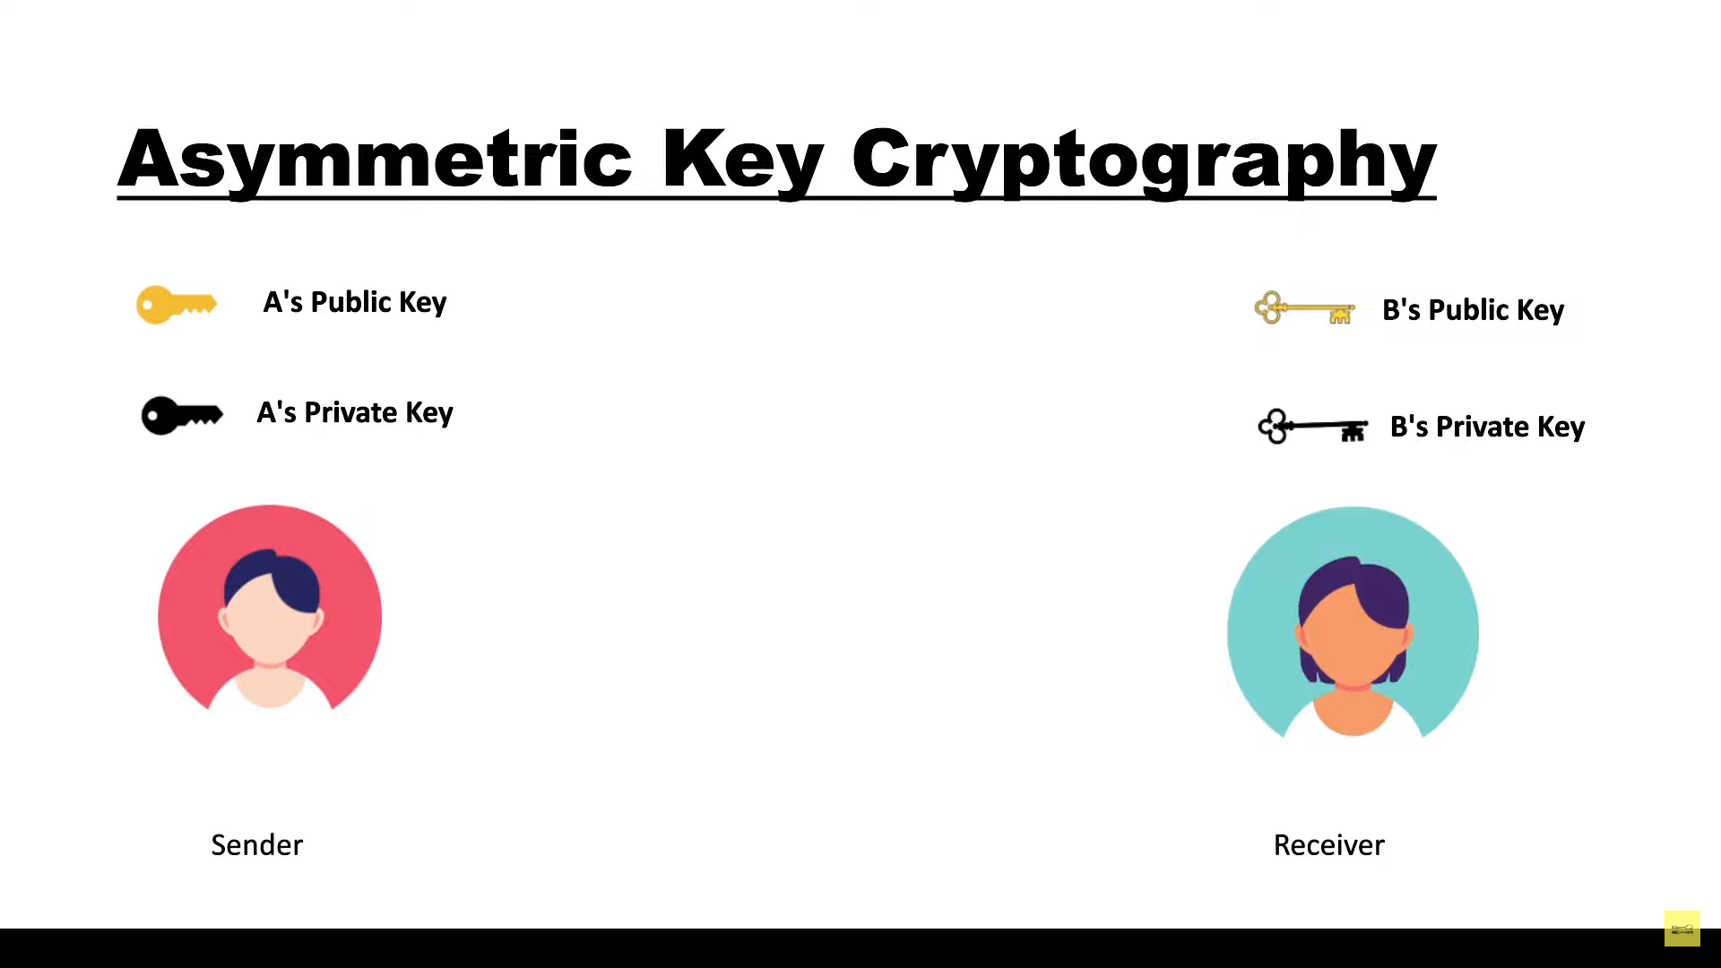

Slide 13
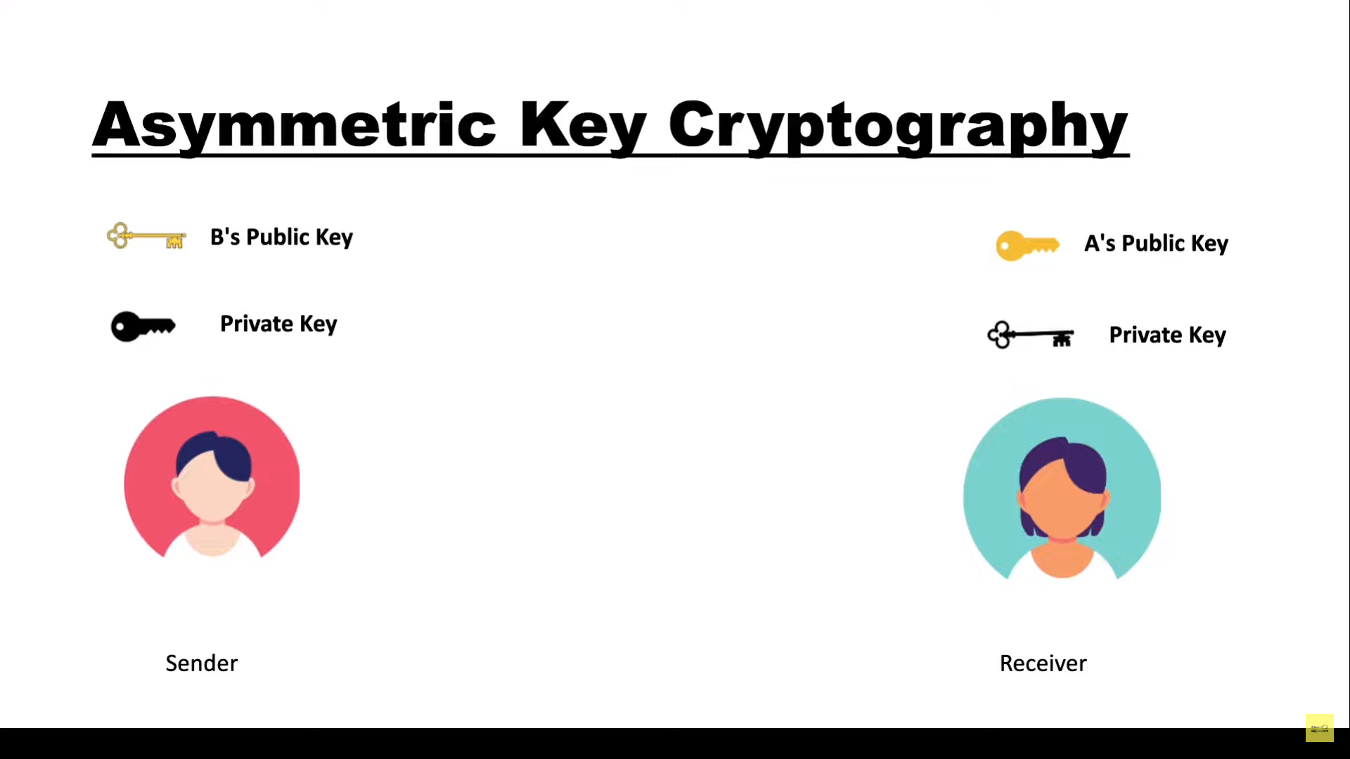

Slide 14
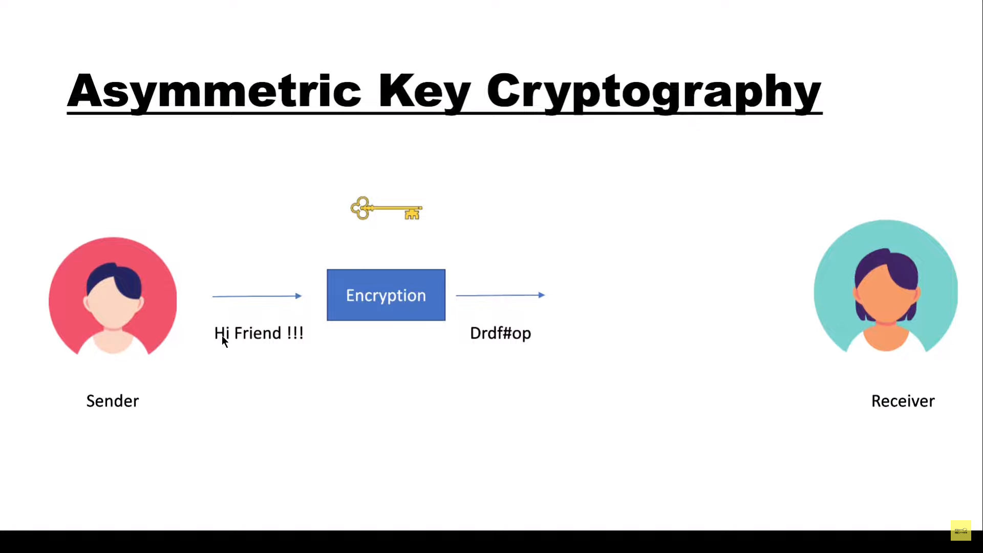

Slide 15
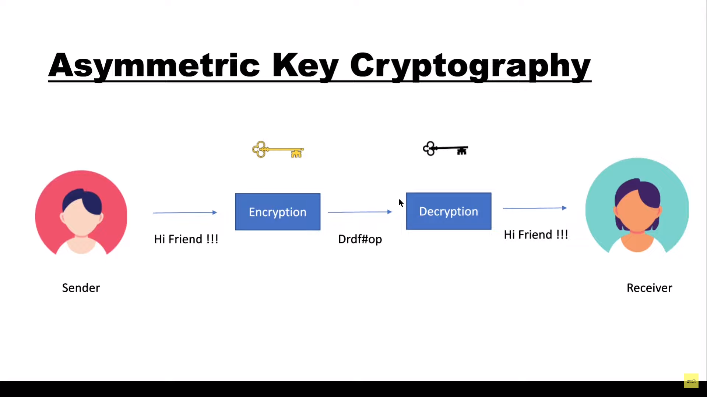

Slide 16
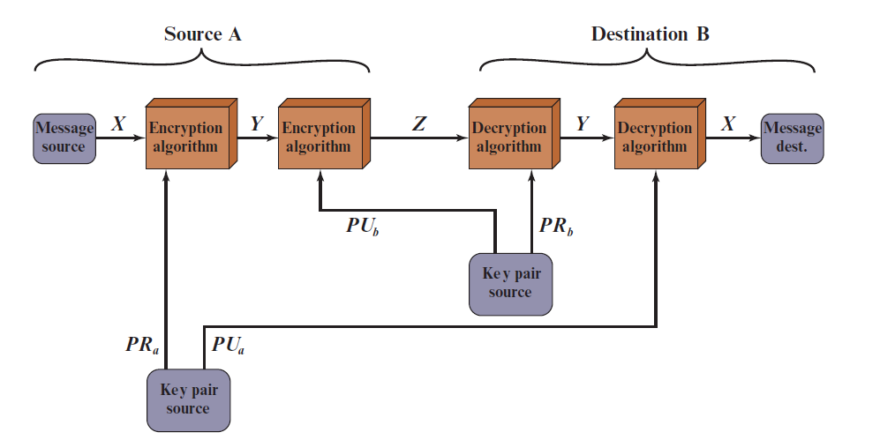
Applications for Public-Key Cryptosystems
Public-key systems are characterized by the use of a cryptographic algorithm with two keys, one held private and one available publicly.
Depending on the application, the sender uses either the sender’s private key or the receiver’s public key, or both, to perform some type of cryptographic function

Slide 17
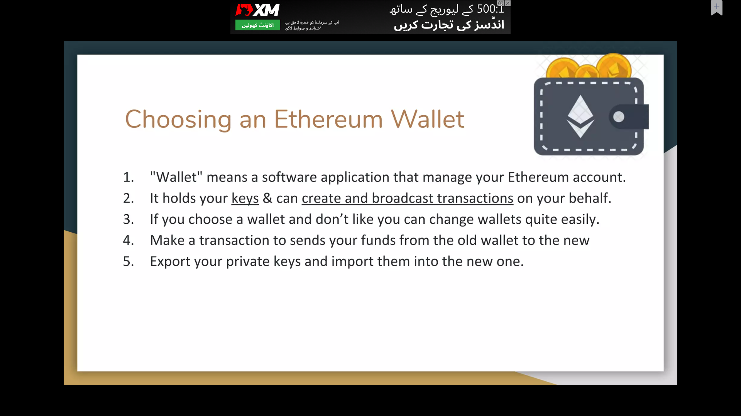
Wallet

Slide 18
Choosing an Ethereum Wallet
Wallet means a software application that manages your Ethereum Account.
It holds your keys and can create and broadcast transactions on your behalf.
If you choose a wallet and don’t like you can change wallets quite easily.
Make a transaction to send your funds from the old wallet to the new.
Export your priate keys and import them into the new one

Slide 19
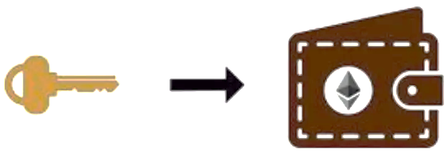
Types of Wallet
Cold Wallet
Hot Wallet
Mobile Wallet
Desktop Wallet
Web-based Wallet
Generally, the more popular a wallet application is , the more trustworthy it is likely to be
It is good practice to avoid “putting all your eggs in one basket” and have you Ethereum accounts spread across a couple of wallets.

Slide 20
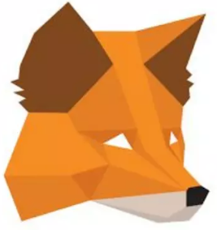
Some good starter wallets
Metamask
Browser extension wallet that runs in your browser
It is easy to use and convenient for testing
Able to connect to a variety of Ethereum nodes and test blockchains.

Slide 21
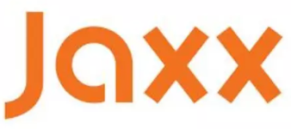
Some good starter wallets
Jaxx
Multiplatform and multicurrency wallet that runs on a variety of Operating Systems
It is often a good choice for new users as it is designed for simplicity and ease of use.
Jaxx is either a mobile or a desktop wallet

Slide 22
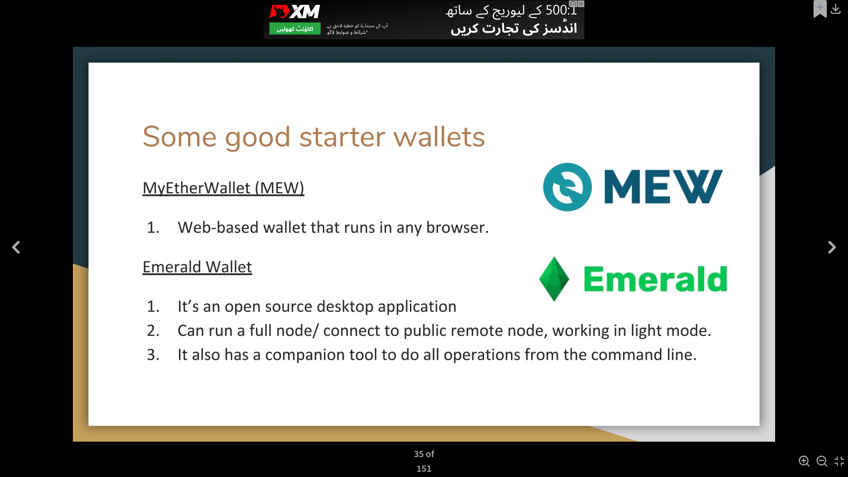
Some good starter wallets
MyEtherWallet (MEW)
Web-based wallet that runs in any browser.
Emerald Wallet
It is an open-source desktop application
Can run a full node/ connect to public remote node, working in light mode.
It also has a comparison tool to do all the operations from the command line

